Slide 1

Language Model Book Processing
Leveraging GPT-3/LLM for Interactive Book Insights
Team Members: Rajeev Koneru, Nischay Sai Cherukuri, Pranav Sai Putta

Slide 2

Introduction:
Project Concept: In the era of digitization, reading has transformed. We aim to harness the power of modern language models to extract insights from any book, enhancing the reading experience and optimizing the process of information extraction.

Slide 3
Scope of the Project:
Book Processing: Our primary focus is to develop a platform where users can upload books in various formats (e.g., PDF).
AI-Powered Analysis: Using GPT-3/LLM, the system will generate summaries, conduct Q&A sessions based on the book's content, and extract main topics or themes.
User-Centric Platform: The project will be hosted as a Streamlit application on AWS, prioritizing user experience and interactivity.

Slide 4
Data Sources:
User-Uploaded Books:
Description: "Our primary data source is the content users provide. They have the ability to upload books to our platform."
Formats Supported:
PDF: "A widely used format for digital books and documents."
Language Model:
Description: "Though not a traditional 'data source,' interactions and feedback from the GPT-3/LLM model constitute significant input-output dynamics integral to our system. This interaction shapes the insights and answers generated."
Data Security & Ethics:
No Personal Data Collection: "Our system focuses solely on the content of the books and does not require or store personal data of the users."

Slide 5
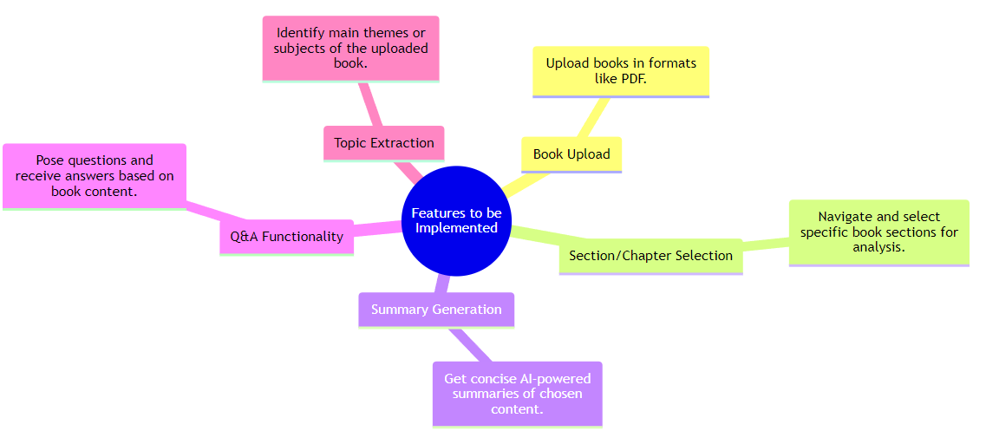
Features to be Implemented

Slide 6
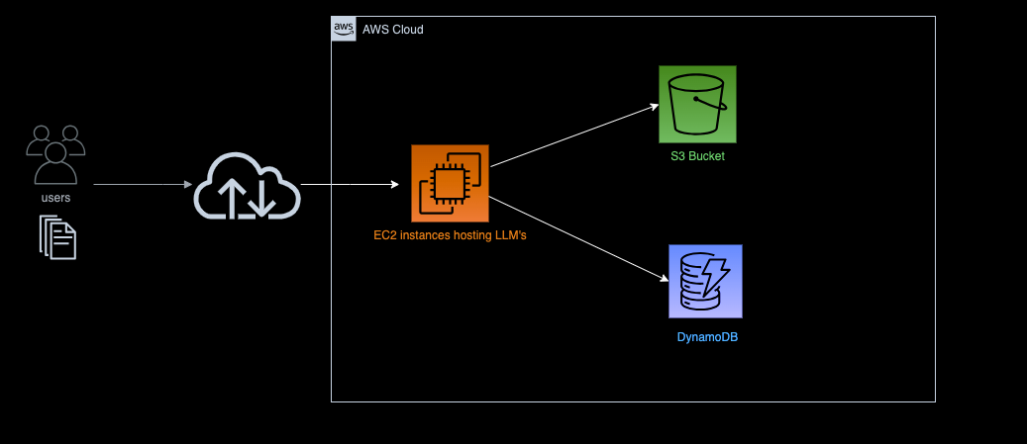
Logical Architecture

Slide 7
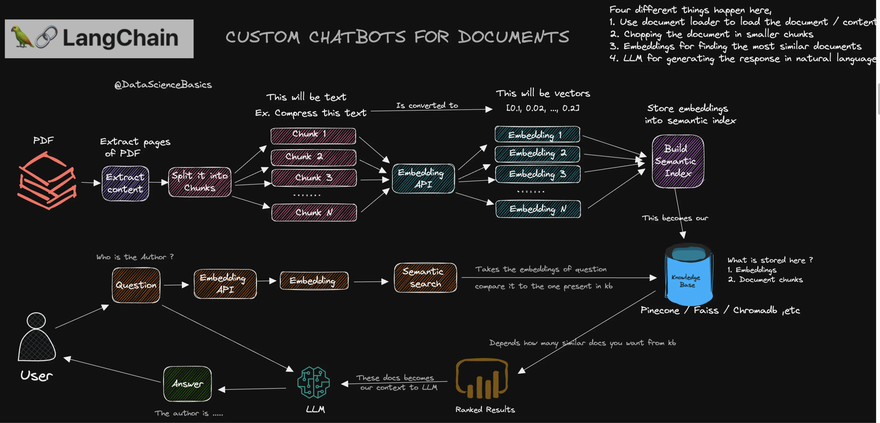
LLM Architecture

Slide 8

Outcomes
1. Enhanced Reading Experience:
Quick, AI-powered summaries allow users to grasp content faster.
2. Dynamic Interaction:
Q&A functionality offers a deeper dive into specific book content, making reading more interactive.
3. Time Efficiency:
Users can quickly gain insights without reading the entire book, aiding researchers, students, and casual readers.
4. User-Centric Platform:
Streamlit application ensures a seamless and intuitive user interface on AWS.

